Slide 1

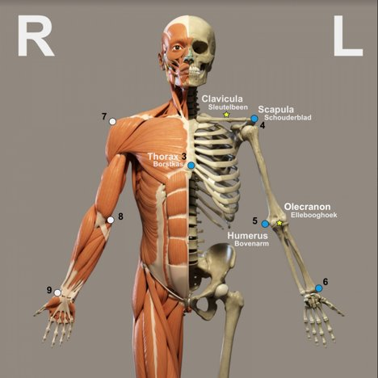

Ortho Eyes
Dr. Tony Andrioli​
Raphael, Brice, Eddie, Hassan, Arjun, Lennart

Slide 2
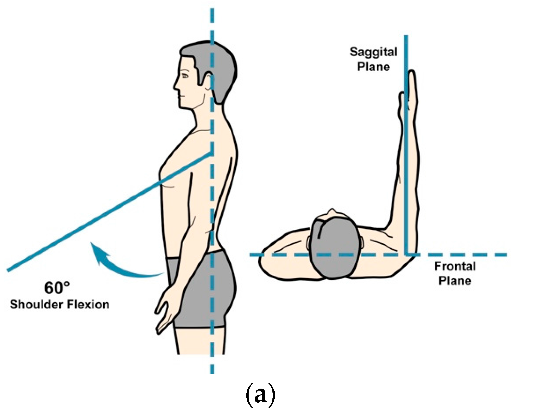


Understanding The Exercises
Origin of the data te voegen
Raw Data
Converted

Slide 3
Understanding The Exercises:
VS
Raw Data
Converted data
Only 1 Raw Data & Converted data.
Comparing raw data vs converted data through visualization
Verifying the correct working of the visualization / checking work of previous group.

Slide 4

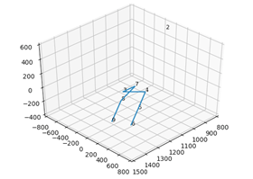
Understanding The Exercises:
Visualization:
Matplotlib

Slide 5

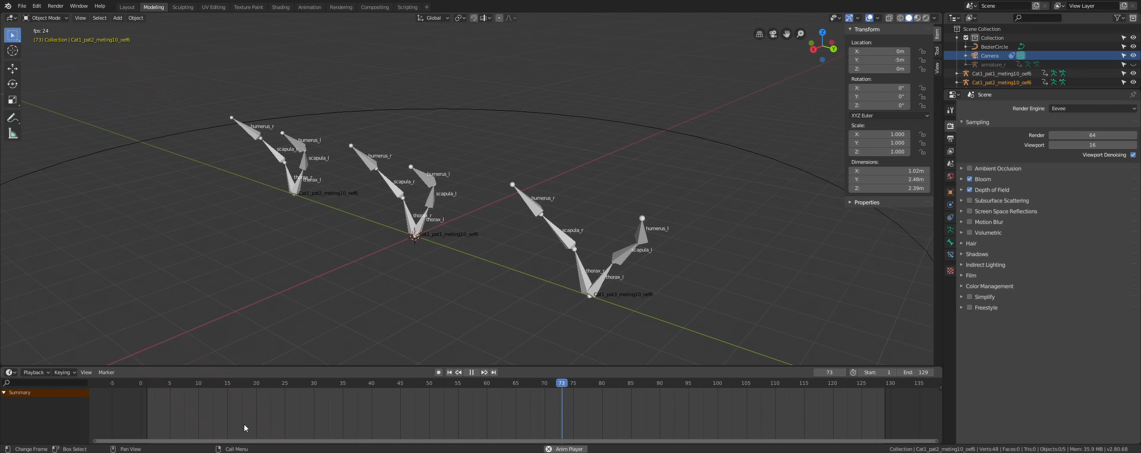
Understanding The Exercises:

Slide 6
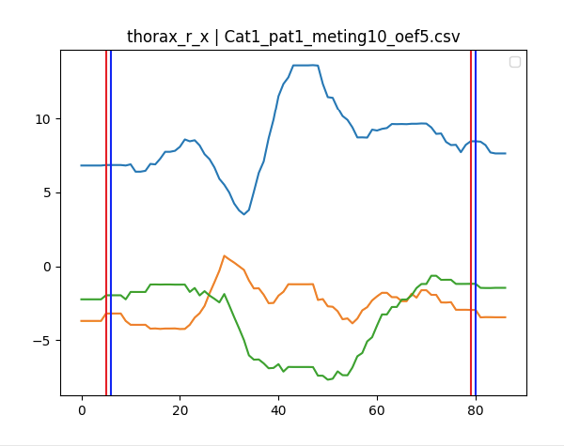
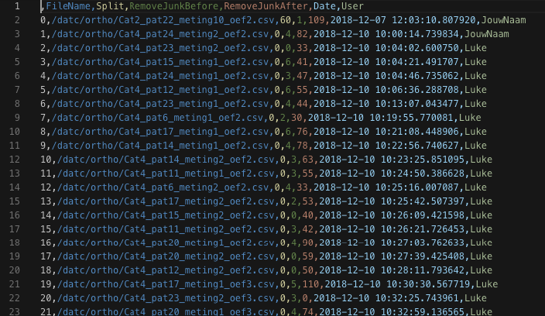
Cleaning methods
We know the previous group manually cleaned the data, these are almost 1400 file files.

Slide 7
Coming week
Research on relevant topics
Understand the basic analysis steps from last group
Through machine learning:
i.e. try to predict the correct patient groep.

Slide 8
Research
Subject of research
Movement & Sensors | Examples on cleaning data etc | Translating / Enriching position and location of sensor data.
How they look at certain problems, how they handle their data etc.

Slide 9
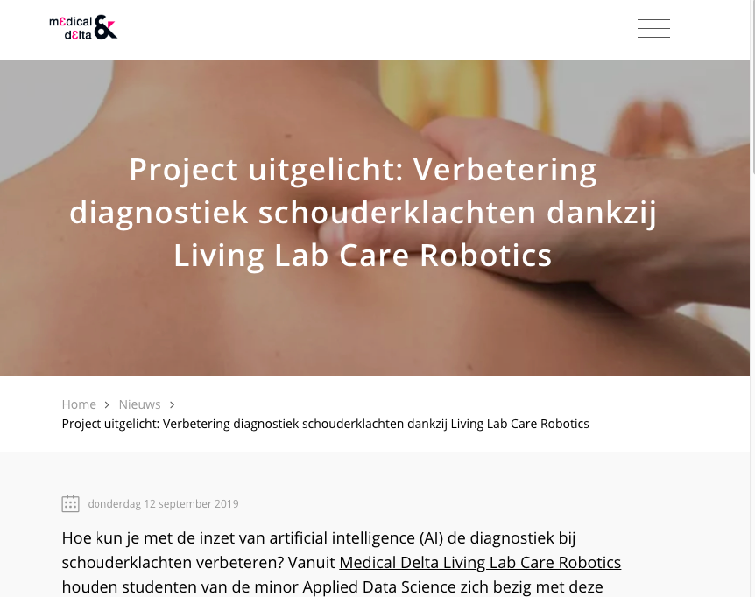
News article

Slide 10
Questions & Suggestions
?

